Slide 1
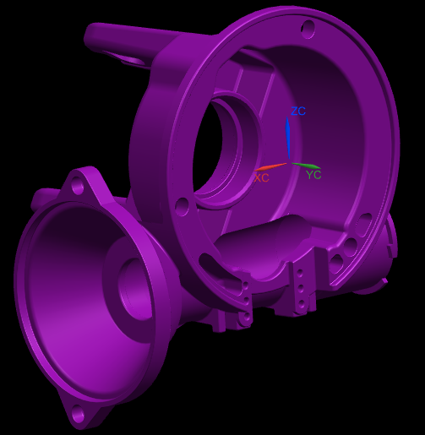
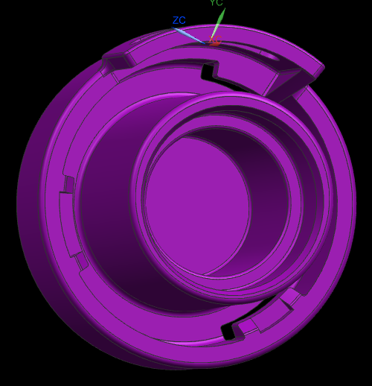
CCM-86: Low Mass Plastic CEPS Housing
Last updated: July 14, 2015
Description
A low mass plastic CEPS housing to replace aluminum housings
Motivation: 7.5
Deliverables
Development of material, geometry and processing
Evaluate prototype performance and durability
Timing
May 2015 – AM bottoming results
July 2015 – Received 25 more housings
August 2015 – Impact Testing
Team Members/Customers
Team: Brandon King, Jason Rutkiewicz, Nick Mehl,
Brian Magnus
Customers: Pursuits Team

Slide 2
CCM-86: Low Mass Plastic CEPS Housing
Last updated: July 14, 2015
Status Update:
First tuning loop parts being dimensionally evaluated and tested
CMM of all critical dimensions
Thermal cycling with backdrive evaluations at each stage
Thermal cycling with CMM of critical dimensions
Completed 1 life of Haitec 60 Nm bottoming
Noticed free play in worm axis
Bearing bore on the motor side too large. Will be addressed in next tuning loop
Material being evaluated by Casey Bentoski in METlab
Challenges:
Tuning dimensions to tolerance
Functional measurement plan
Thermal stability of parts
Creep stability of parts
Cost savings to Aluminum
Next Actions:
Impact testing
AM friction vs temperature
NVH
Tuning the molds
Supplier - insert retention testing

